Slide 1

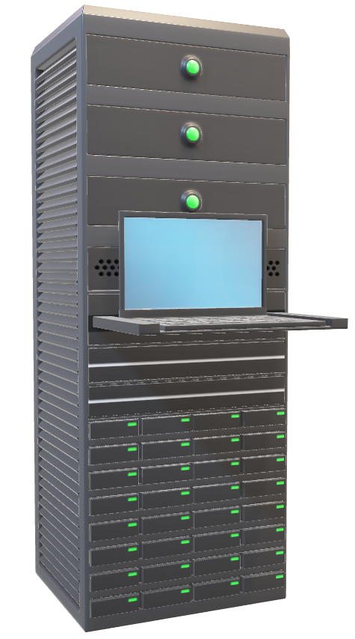
You shall not pass
John BATAGNE
Jimmy MARTEL

Slide 2
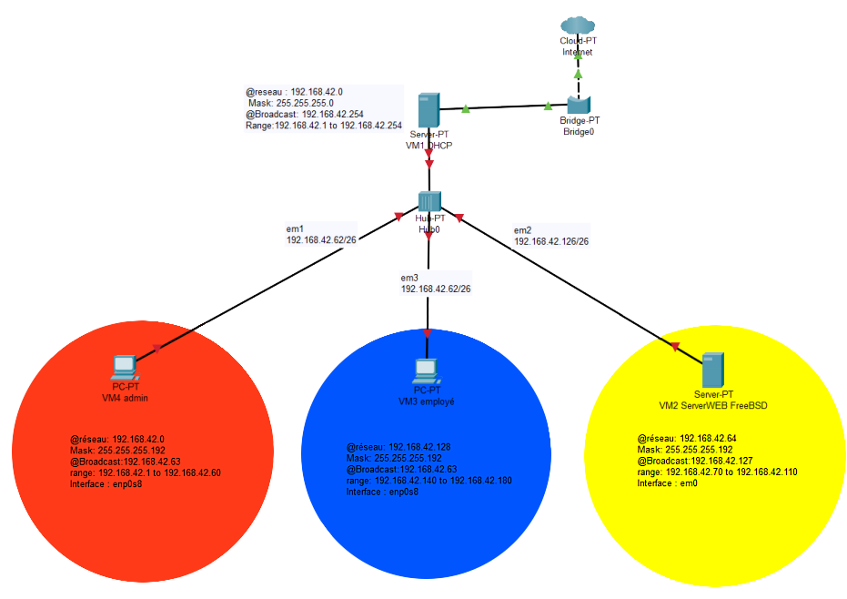

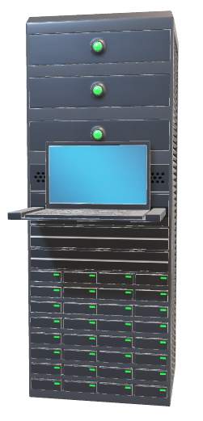
Network Scheme
Server-PT
VM1 DHCP

Slide 3

PRELIMINARIES
VM1
VM2
VM3
VM4
DHCP - OPENBSD
Web Server – FREEBSD12
Employee – Debian 10
Admin - Debian 10
Lan 2 - server
Lan 3 - employee
Lan 1 - administration

Slide 4
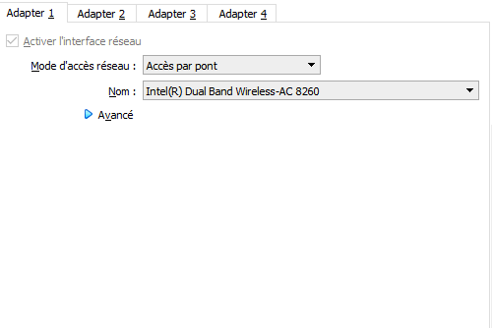
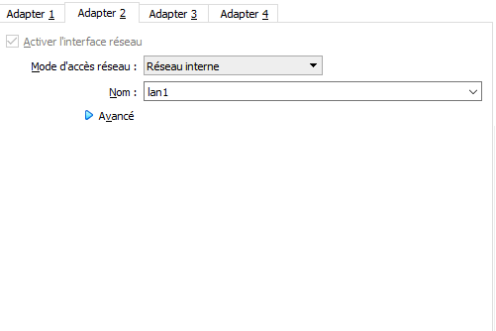
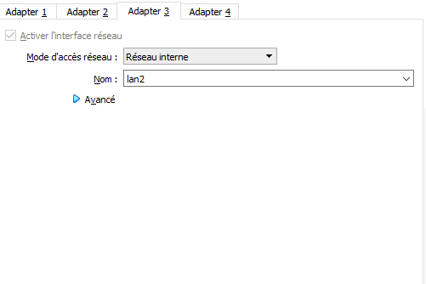


VM1
DHCP - OPENBSD
Configuration of each interface in VirtualBox
VM2
VM3
VM4

Slide 5
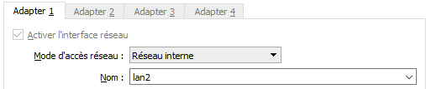
VM2
Web Server – FREEBSD12
Configuration of interface in VirtualBox
VM1
VM3
VM4

Slide 6
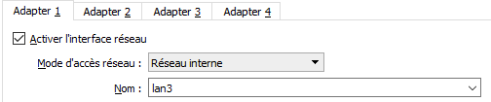
VM3
Employee – Debian 10
Configuration of interface in VirtualBox
VM1
VM2
VM4

Slide 7
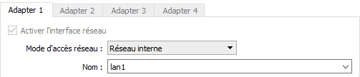
VM4
Employee – Debian 10
Configuration of interface in VirtualBox
VM1
VM2
VM3

Slide 8

DHCP Configuration
VM1
VM2
VM3
VM4

Slide 9
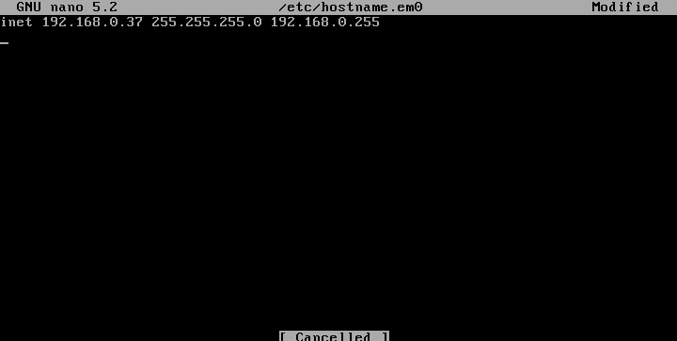

VM1
Configuration of the different interface
Bridge
Lan 1
Lan 2
Lan 3
VM2
VM3
VM4

Slide 10
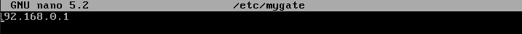
VM1
Configuration of mygate file
/etc/mygate
VM2
VM3
VM4

Slide 11
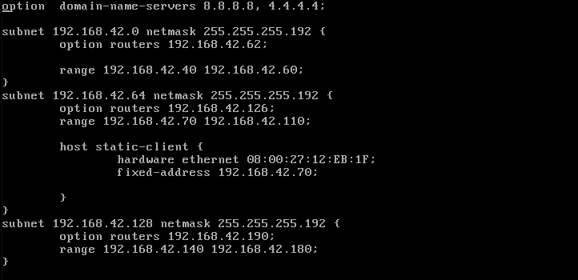

VM1
Configuration of the DHCP
Lan 1 : Administration
Gateway : 192.168.42.62/26
Available addresses :
192.168.42.40/26 - 192.168.42.60/26
dhcpd.conf
VM2
VM3
VM4

Slide 12
VM1
Configuration of the DHCP
Lan 2 : Server
Gateway : 192.168.42.126/26
Available addresses :
192.168.42.70/26 - 192.168.42.110/26
Static reservation address for web server thanks to mac address :
192.168.42.70/26
dhcpd.conf
VM2
VM3
VM4

Slide 13
VM1
Configuration of the DHCP
Lan 3 : Employee
Gateway : 192.168.42.190/26
Available addresses :
192.168.42.140/26 - 192.168.42.180/26
dhcpd.conf
VM2
VM3
VM4

Slide 14

VM1
Configuration of the DHCP
Lan 1 : Administration
Gateway : 192.168.42.62/26
Available addresses :
192.168.42.40/26 - 192.168.42.60/26
dhcpd.conf
Lan 2 : Server
Gateway : 192.168.42.126/26
Available addresses :
192.168.42.70/26 - 192.168.42.110/26
Static reservation address for web server thanks to mac address :
192.168.42.70/26
Lan 3 : Employee
Gateway : 192.168.42.190/26
Available addresses :
192.168.42.140/26 - 192.168.42.180/26
VM2
VM3
VM4

Slide 15


Installation and Configuration
VM2
And installation of

Slide 16
VM2
Installation Nginx and Php
Installation Nginx
pkg install -y nginx
Enable Nginx on boot
sysrc nginx_enable =YES
Start Nginx
Service nginx start
Installation Php
pkg install php72 php72-mysqli php72-mbstring php72-zlib php72-curl php72-gd php72-json
sysrc php_fpm_enable=YES
service php-fpm start
VM1
VM3
VM4

Slide 17
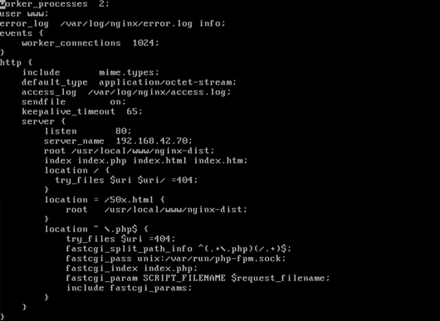
VM2
NGINX Configuration
VM1
VM3
VM4

Slide 18
VM2
NGINX Configuration
Add index.php in order to make website
Look at it
VM1
VM3
VM4

Slide 19
VM2
NGINX Configuration
Include of php location to telling website to check multiple file and execute script in function of the request‘s
VM1
VM3
VM4

Slide 20
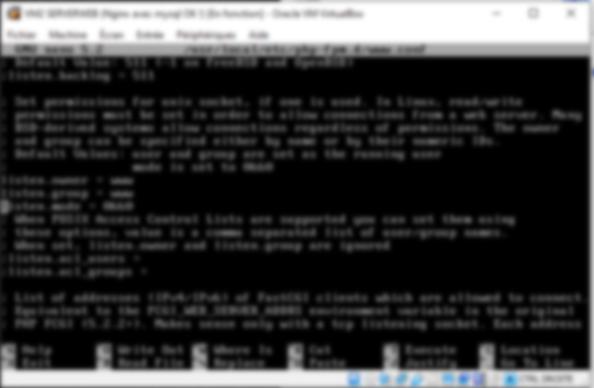
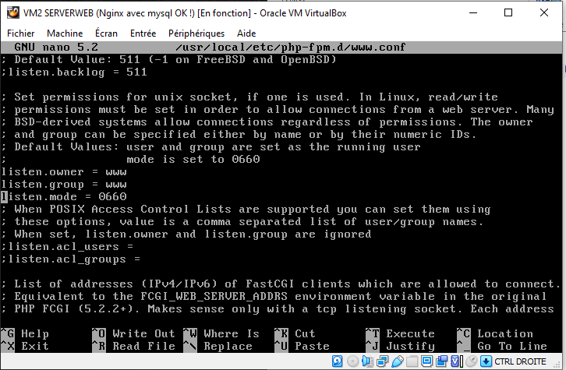
VM2
PHP Configuration
Uncomment this line in /usr/local/etc/php-fpm.d/www.conf
Set permissions for unix socket, if one Is used.
VM1
VM3
VM4

Slide 21

Configuration
VM2

Slide 22
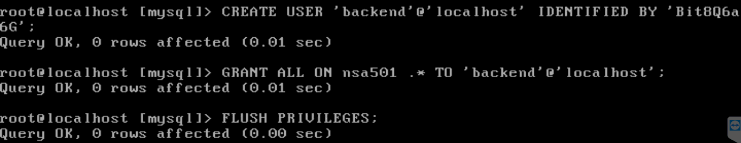
VM2
MYSQL Configuration
VM1
VM3
VM4

Slide 23
VM2
MYSQL Configuration
Creation of the database.
VM1
VM3
VM4

Slide 24
VM2
MYSQL Configuration
Creation of the database.
Importation of the database.
VM1
VM3
VM4

Slide 25
VM2
MYSQL Configuration
Creation of the database.
Importation of the database.
Creation of the user with is name and it password
VM1
VM3
VM4

Slide 26
VM2
MYSQL Configuration
Creation of the database.
Importation of the database.
Creation of the user with is name and it password
Grant their access for the
VM1
VM3
VM4

Slide 27
Packet Filtering Configuration
VM1

Slide 28
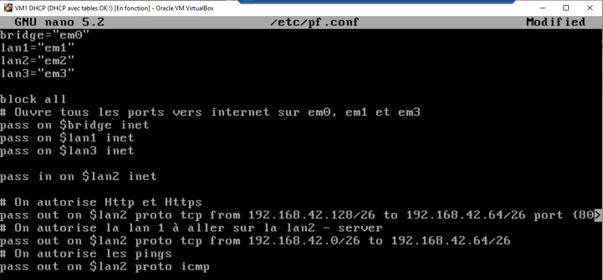
VM1
Configuration of Network Security
pf.conf
VM2
VM3
VM4

Slide 29
VM1
Configuration of Network Security
pf.conf
Déclaration des variables que nous allons utiliser :
Cartes 0 – 1 – 2 – 3
VM2
VM3
VM4

Slide 30
VM1
Configuration of Network Security
pf.conf
Déclaration des variables que nous allons utiliser :
Cartes 0 – 1 – 2 – 3
Bloquage de tous les ports
Ouverture de tous les ports vers internet sur em0, em1 et em3
VM2
VM3
VM4

Slide 31
VM1
Configuration of Network Security
Déclaration des variables que nous allons utiliser :
Cartes 0 – 1 – 2 – 3
pf.conf
Bloquage de tous les ports
Ouverture de tous les ports vers internet sur em0, em1 et em3
Autorisation de toutes les requêtes venant de lan2 vers internet mais pas l’inverse
VM2
VM3
VM4

Slide 32
VM1
Déclaration des variables que nous allons utiliser :
Cartes 0 – 1 – 2 – 3
pf.conf
Bloquage de tous les ports
Ouverture de tous les ports vers internet sur em0, em1 et em3
Autorisation de toutes les requêtes venant de lan2 vers internet mais pas l’inverse
Autorisation HTTP et HTTPS
Autorisation du lan1 vers lan2 serveur
Autorisation des pings vers lan2
VM2
VM3
VM4

Slide 33


Thanks for your attention

